Slide 1
Benefits of the low doses of radiation delivered in medical imaging
Cynthia H. McCollough, PhD, DABR, FAAPM, FACR, FAIMBE
Professor of Medical Physics and Biomedical Engineering
Director, CT Clinical Innovation Center
Mayo Clinic, Rochester, MN

Slide 2
DISCLOSURES
Research Support:
Off Label Usage
None
NIH | Other
EB 017095 | Siemens Healthcare
EB 017185 | Mayo Center for Individualized Medicine Award
EB 016966
DK 100227
HR 046158
RR 018898

Slide 3
Please turn off your cell phone!

Slide 4

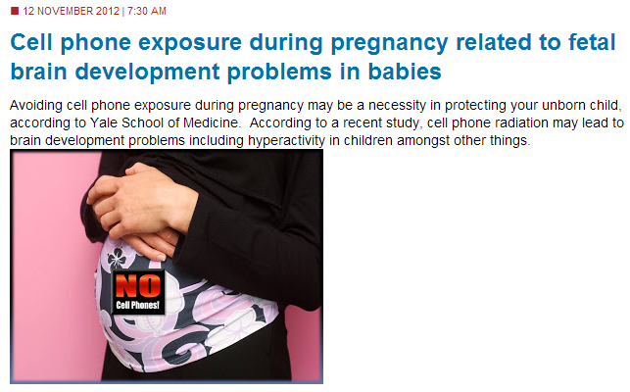
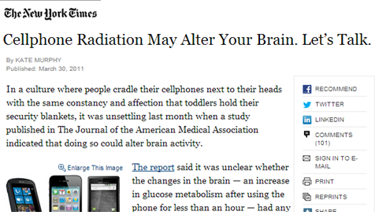
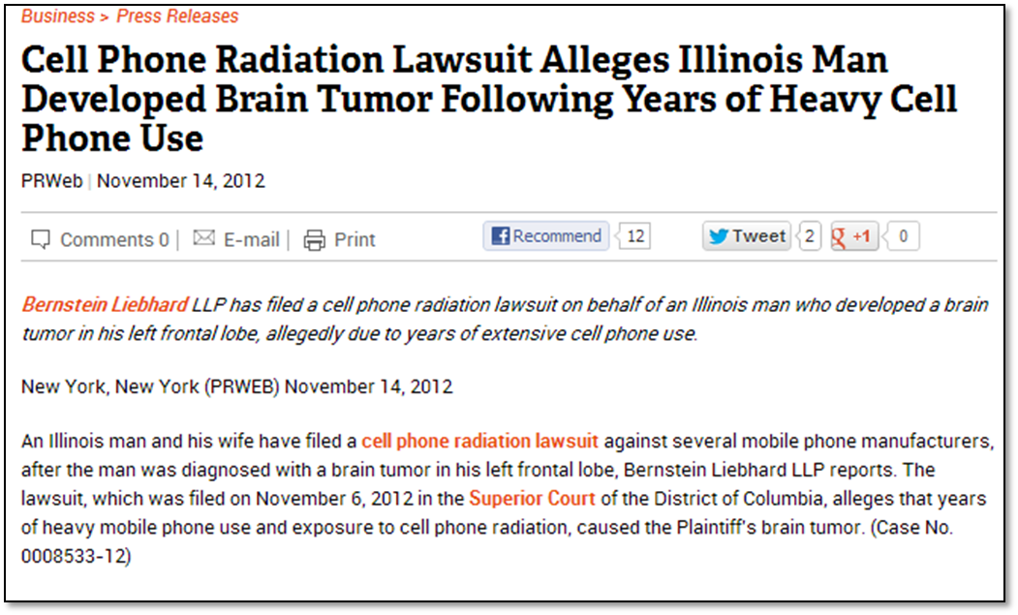
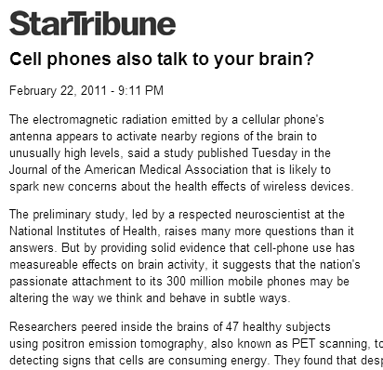
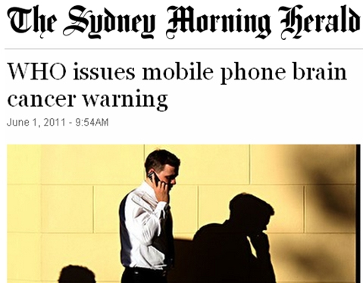

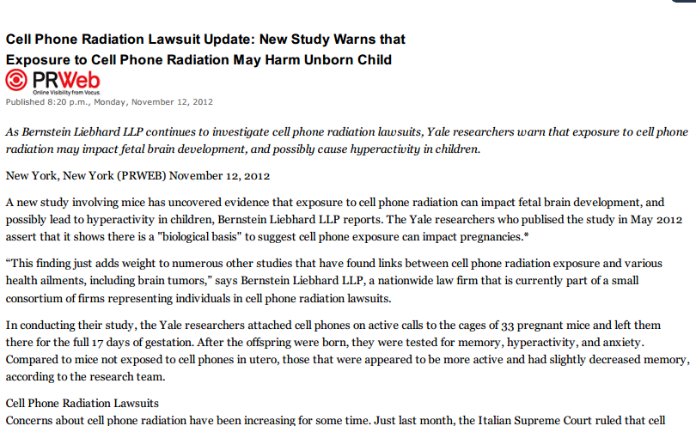
Notes:
http://hamptonroads.com/2012/11/cell-phone-exposure-during-pregnancy-related-fetal-brain-development-problems-babies
http://www.chron.com/business/press-releases/article/Cell-Phone-Radiation-Lawsuit-Alleges-Illinois-Man-4038427.php
http://www.nytimes.com/2011/03/31/technology/personaltech/31basics.html?_r=0
Http://assets.nydailynews.com/polopoly_fs/1.11676.1314093037!/img/httpImage/gal-frontpage-0601-jpg.jpg
http://www.startribune.com/lifestyle/health/116707389.html
http://www.sfgate.com/business/prweb/article/Cell-Phone-Radiation-Lawsuit-Update-New-Study-4030442.php
http://thesciencebitdotnet.files.wordpress.com/2011/06/smhphonecancer.jpg?w=500

Slide 5
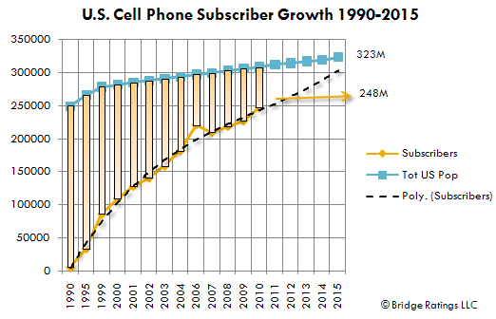
Growth in U.S. cell phone use
Subscribers (in Millions)
Notes:
http://www.deadzones.com/2006/04/1805-million-us-cell-phone-users-last.html#.UKwF4Yc812A
http://orange.eserver.org/issues/7-3/lloyd.html

Slide 6
As of 2016, over 50 percent of homes and apartments had only cellphone service

Slide 7
Why such exponential growth?
Because the benefit far exceeds the risk
Whether risk is real or imaginary
Regardless of alarmist media stories
Individuals deem cell phones of sufficient benefit to continue the mass migration from land lines to cell phones

Slide 8
But what about public health?
If there is even the slightest risk that cell phones will cause cancer, and hundreds of millions of Americans are using them, thousands of Americans may die from cell-phone induced cancer!

Slide 9
We need to reduce risk
ALARA:
ASARA: Keep your calls As SHORT As Reasonably Achievable
Use alternate technology in children
Land lines
No cordless phones
No walkie talkies
Buy headsets with cables that are As LONG As Reasonably Achievable -or- Buy cell phones with power output As LOW As Reasonably Achievable

Slide 10
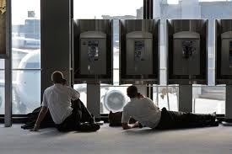
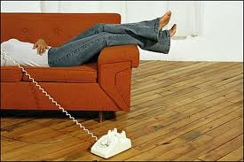
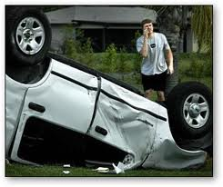
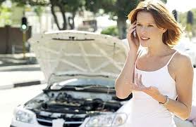
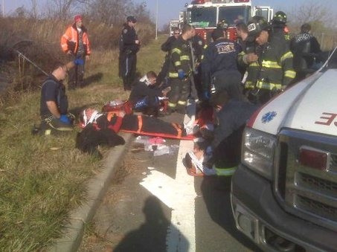
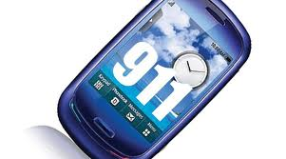
But all actions have consequences
Inconvenience
Delays in getting help
Life threatening

Slide 11
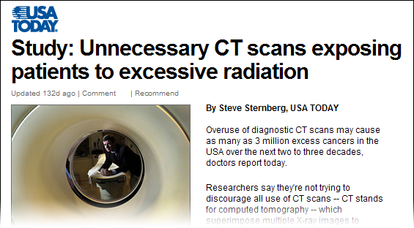
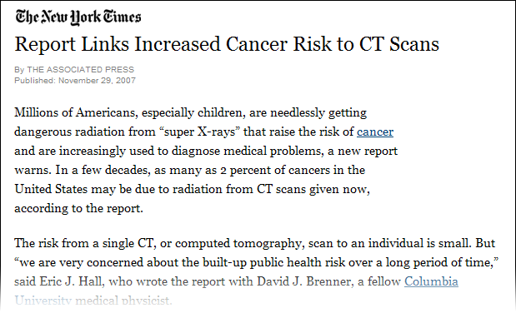
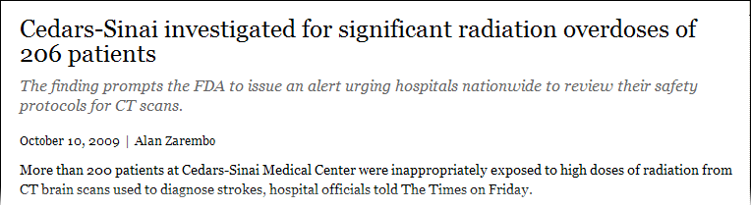
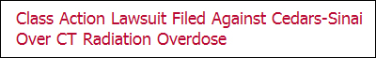

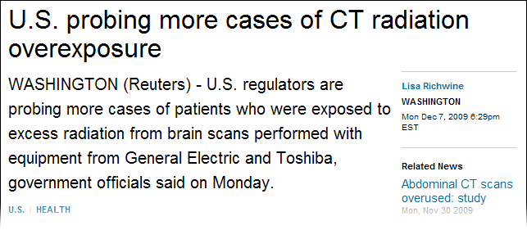
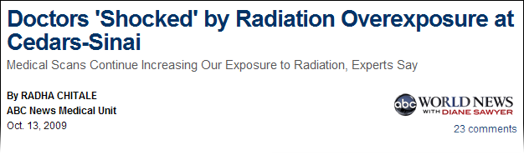
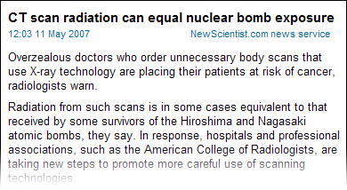
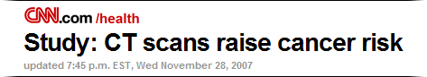
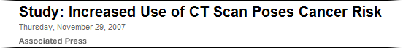

Slide 12
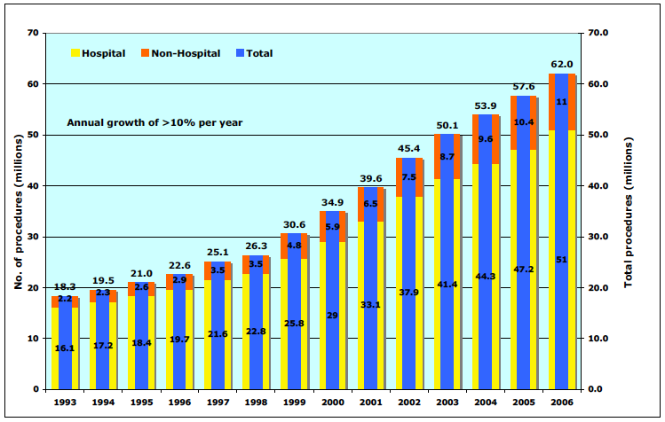
Exponential growth in CT imaging
National Council on Radiation Protection. IONIZING RADIATION EXPOSURE OF THE POPULATION OF THE UNITED STATES in 2006, Report 16. (2009)

Slide 13
Why such exponential growth?
Because the benefit far exceeds the risk
Whether risk is real or imaginary
Regardless of alarmist media stories
Physicians and patients consider the health benefits derived from the fast, readily available, definitive medical imaging that CT provides for so many conditions/indications/diagnoses to be of sufficient value to continue using CT at every increasing rates

Slide 14
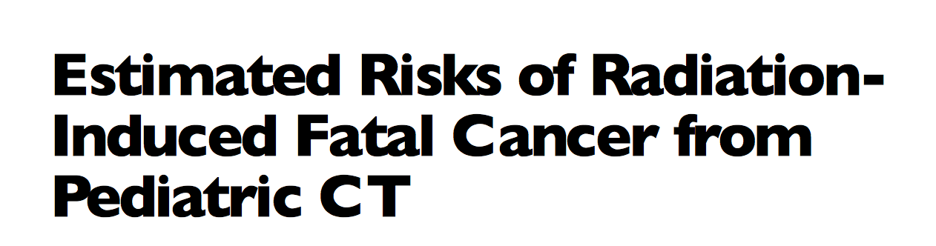
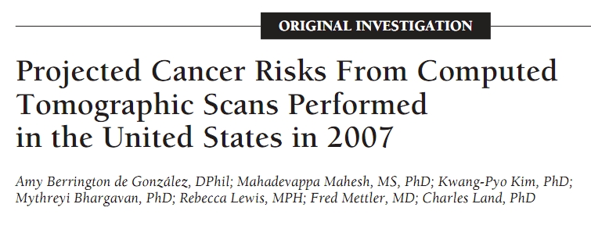
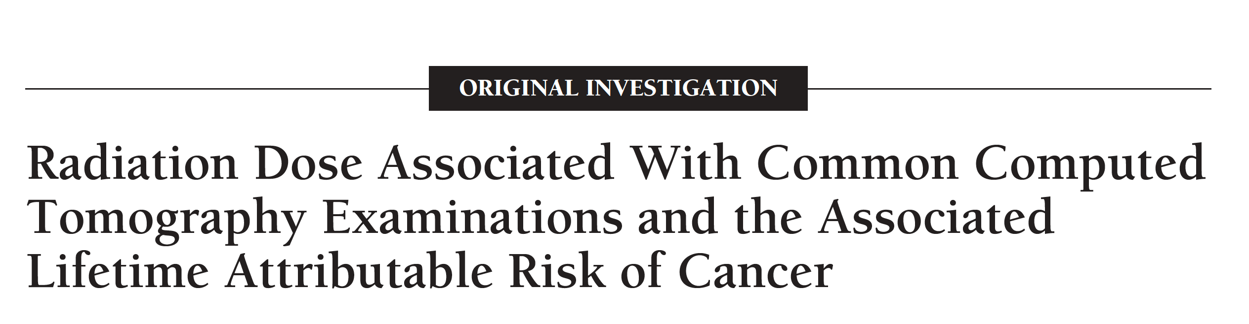
But what about public health?
If there is even the slightest risk that CT will cause cancer, and a hundred million Americans are getting CT exams, thousands of Americans may die from CT induced cancer!
Message to physicians and patients: reduce use of CT

Slide 15
But all actions have consequences
Think about your family’s medical care
Imagine a severe power outage, fire, flood or hurricane
Hospital CT scanners – all of them – down for weeks/months
Emergency department
Hospital scanners
Outpatient scanners
How would doctors care for injured patients
Trauma
ICU, surgical complications, surgical planning
Oncology treatment planning and surveillance

Slide 16
Consider the consequences of lack of CT
Inconvenience
Reschedule exams (outpatient)
Transport patients to another location (inpatient/ED)
Bring in a mobile scanner and transport patients outside
Staff your MR units 24/7 (still wouldn’t work)
Delays in providing care
Try radiography/fluoro/ultrasound first
Stroke patient: Time is brain!
Life threatening

Slide 17
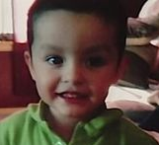
This is who motivates me
Bryan Salinas fell 5 feet out a window
No one witnessed the fall
No one knew if he lost consciousness
Brought to ER: pale, crying and vomiting
According to the American Academy of Pediatrics, CT scans are typically only performed when a child loses consciousness after hitting their head
“A CT scan exposes a child to radiation equal to 300 X-rays, and can require sedation, which is risky”
2012: about a decade into the childhood cancer from CT scare
Doctor discharged child after only a physical exam
Bryan died hours later from a subdural hematoma

Slide 18
Bryan is not alone
Laura Pincher 18
Pulmonary emboli
13 year old Molly Banzhoff
Brain tumor
69 year old Sandra Wood
Bowel obstruction
Lynn Rees, 56
Delayed cancer diagnosis
Warren Bates, 45
Head injury

Slide 19
What is the risk of a CT scan?
Arch Intern Med. 2009;169(22):2078-2086
Authors calculate potential cancers using published radiation risk data. Conclude that 29,000 future cancers could be related to CT scans performed in the U.S. in 2007 (>70 million)… and could translate into about 14,500 cancer deaths.

Slide 20
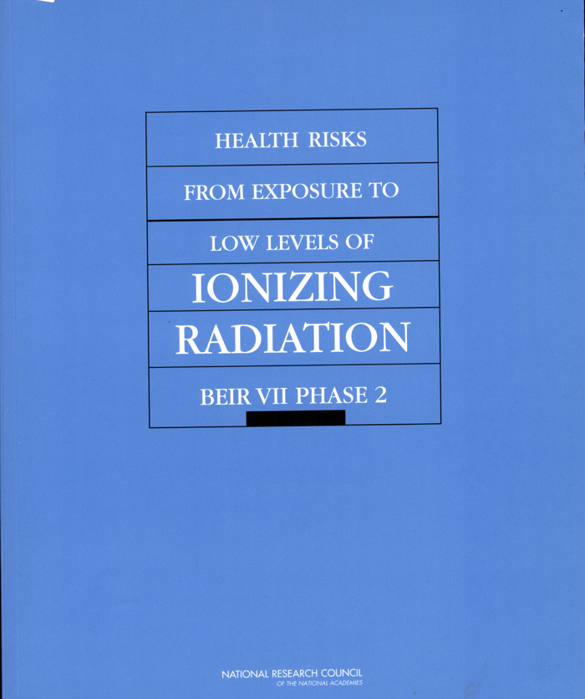
BEIR = Biological Effects of Ionizing Radiation
http://www.nap.edu/openbook.php?isbn=030909156X
(406 pages)

Slide 21
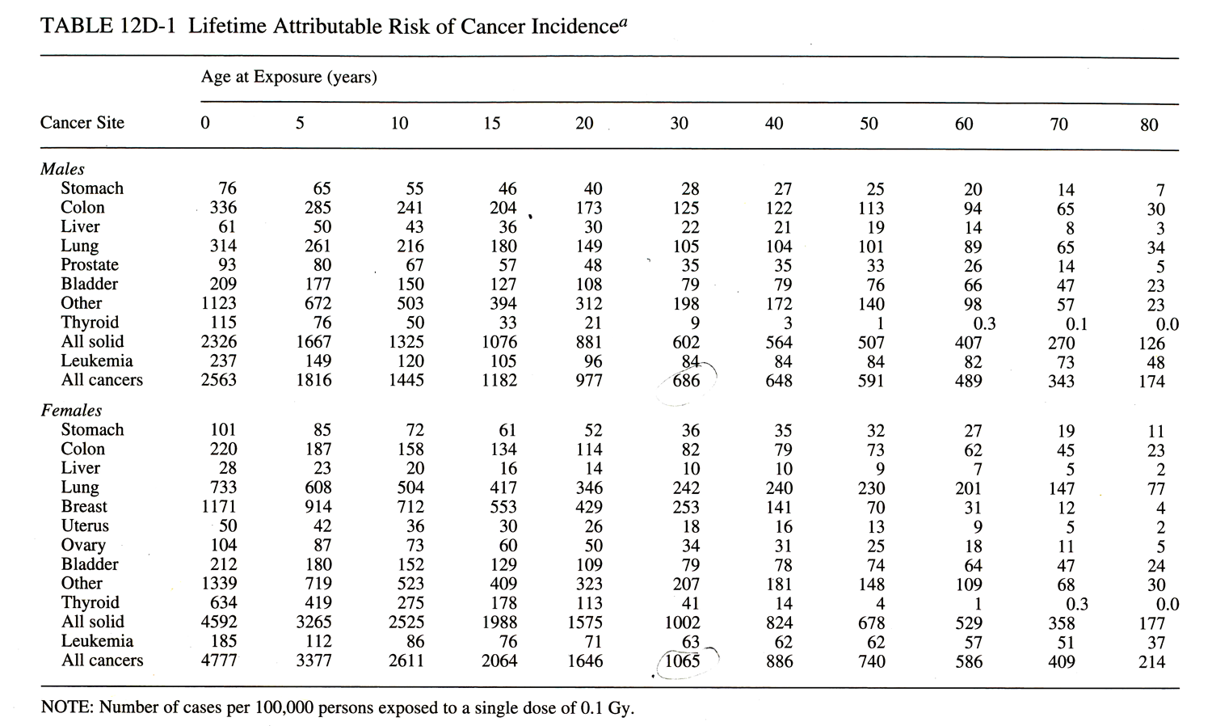
100,000 women aged 30
Single dose of 100 mSv
Incidence over their lifetime

Slide 22
Discussions at this meeting
Magnitude of risk in low dose range
Shape of dose response curve
Linear or not
Threshold or not
Variability in risk estimates due to
Gender
Age
Organ / tissue type
Genetic predisposition
Environmental influences
Small
but likely non-zero
but likely beneficial
and not knowable with any certainty

Slide 23
How to quantify benefits of CT
Medical experience
Compelling cases that demonstrate lifesaving benefit

Slide 24
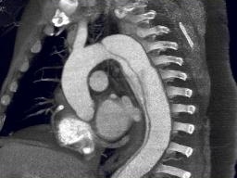
Patient reports to ED with chest pain and shortness of breath
Courtesy of Dr. Jim Brink
Notes:
SAME PATIENT-OBLIQUE MPR.

Slide 25
How to quantify benefits of CT
Case reports
A compelling case that is published

Slide 26
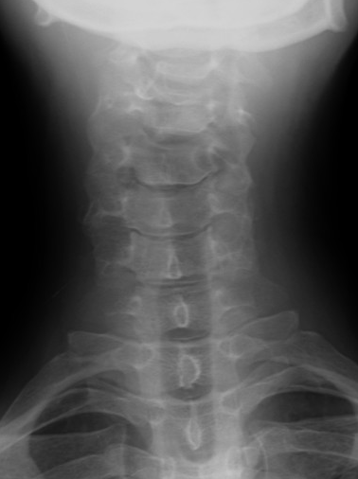
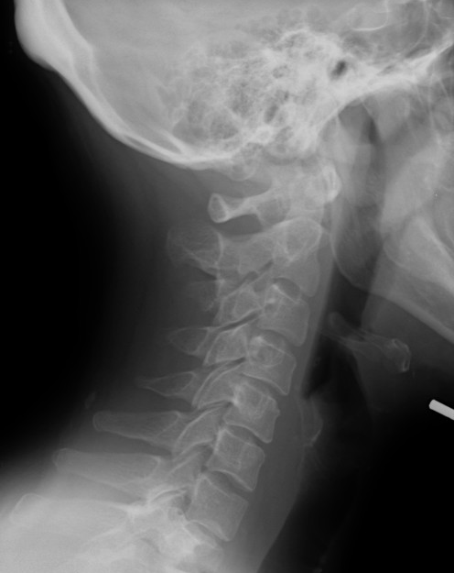
Patient slipped on ice and reports neck and back pain
Lytic
Lesion
Courtesy of Dr. Rajiv Gupta

Slide 27
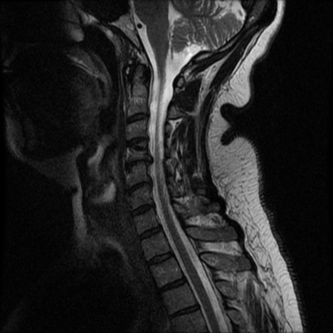
Courtesy of Dr. Rajiv Gupta
Notes:
MRI Neck

Slide 28
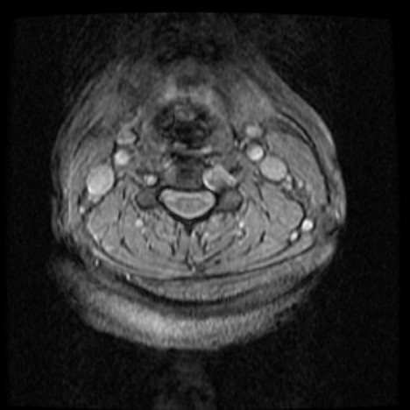
Non-specific and equivocal. Biopsy discussed.
Courtesy of Dr. Rajiv Gupta
Notes:
MRI:

Slide 29
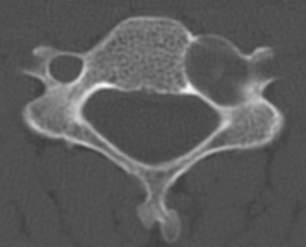
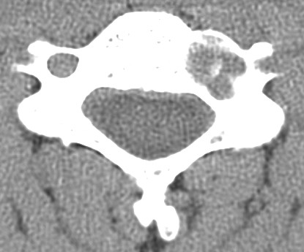
Let’s try a CT first
Courtesy of Dr. Rajiv Gupta
Notes:
CT – bone and ST windows

Slide 30
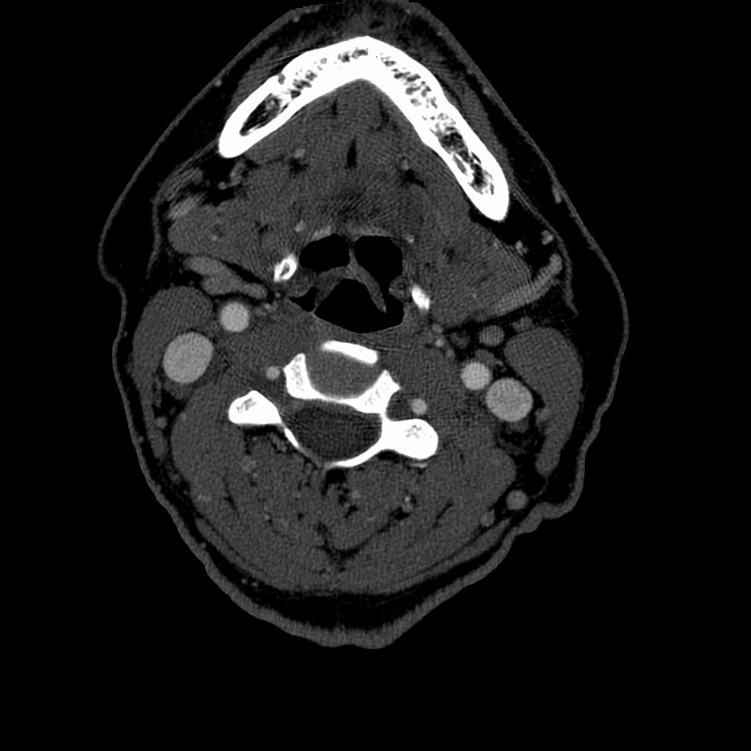
Vertebral
Artery
Courtesy of Dr. Rajiv Gupta
Notes:
CT Angiogram

Slide 31
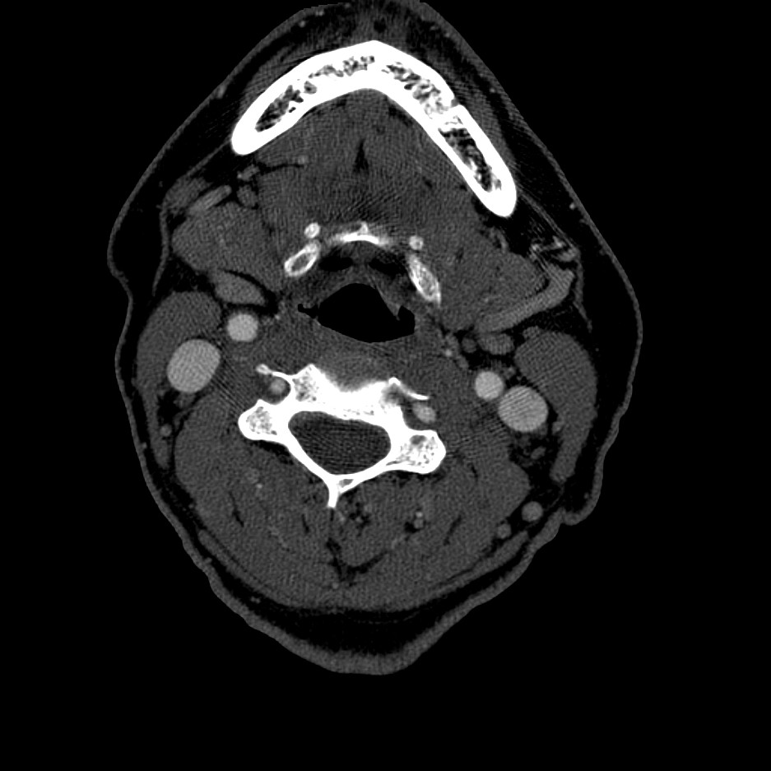
Courtesy of Dr. Rajiv Gupta

Slide 32
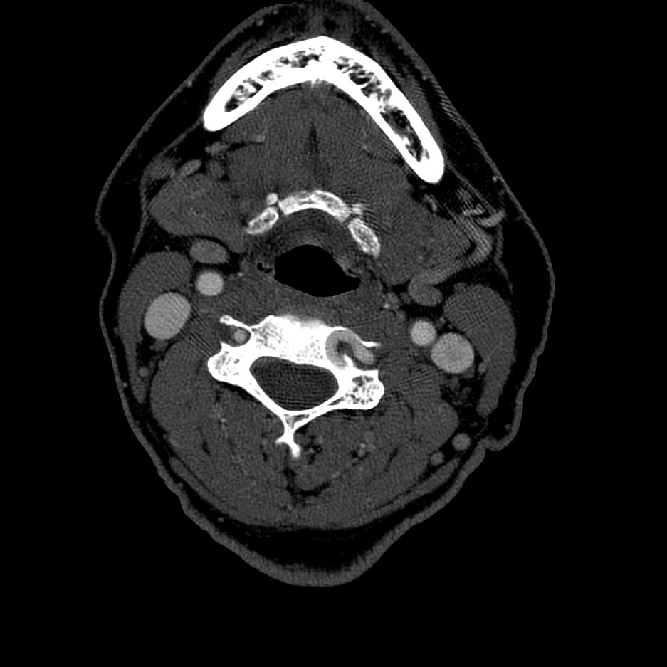
Courtesy of Dr. Rajiv Gupta

Slide 33
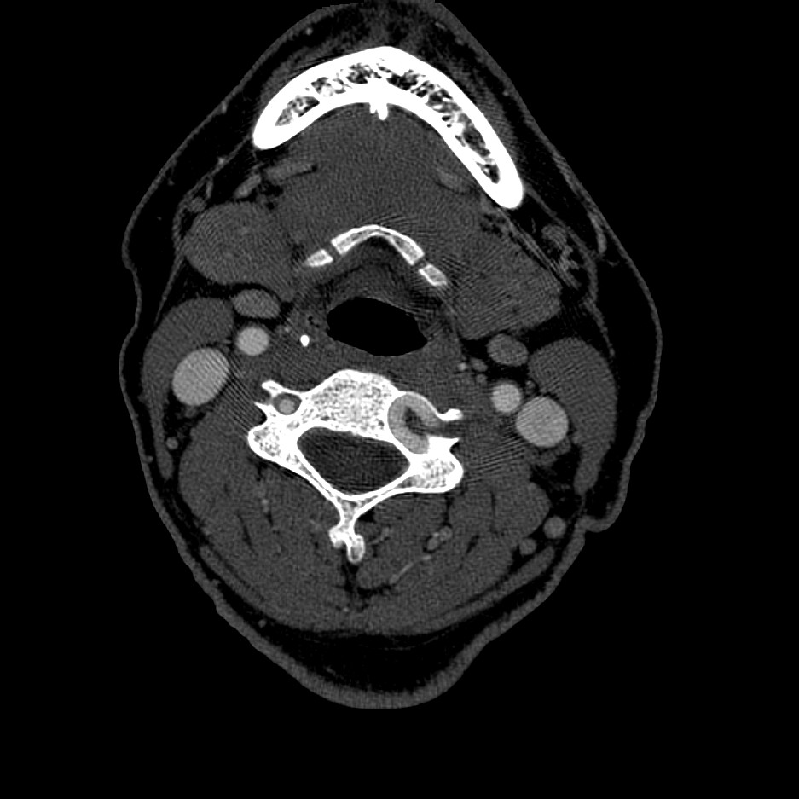
Tortuous Vertebral
Artery
Biopsy would likely have been fatal!
Courtesy of Dr. Rajiv Gupta

Slide 34
How to quantify benefits of CT
Observational/retrospective studies
Compare similar cohorts who were cared for using different diagnostic algorithms, one of which uses CT
Compare patient outcomes, costs, quality of life, etc.

Slide 35
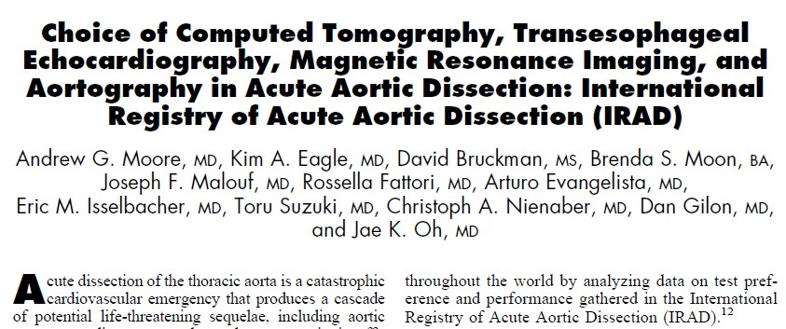

Evaluation of CT for Aortic Dissection
Notes:
Moore AG, Eagle KA, Bruckman D, et al. Choice of computed tomography, transesophageal echocardiography, magnetic resonance imaging, and aortography in acute aortic dissection: International Registry of Acute Aortic Dissection (IRAD). Am J Cardiol 2002; 89(10):1235-1238.
Thoongsuwan N, Stern EJ. Chest CT scanning for clinical suspected thoracic aortic dissection: beware the alternate diagnosis. Emerg Radiol 2002; 9(5):257-261. (cannot find full text)
Yoshida S, Akiba H, Tamakawa M, et al. Thoracic involvement of type A aortic dissection and intramural hematoma: diagnostic accuracy--comparison of emergency helical CT and surgical findings. Radiology 2003; 228(2):430-435.

Slide 36
Should ultrasound (US) be performed before CT?
Smith-Bindman et al., US vs CT for suspected nephrolithiasis. N Engl J Med 2014;371(12):1100-10.
Point of care US in ED vs US in radiology vs CT
30-day high-risk diagnoses with complications: 0.7% in POCUS group, 0.3% in the US group, and 0.2% in the CT, p = 0.30
“...supports the safety of US as first-line imaging test in suspected nephrolithiasis.
Majority of patients (59.3% POCUS and 73% of US) were successfully and safely spared from radiation exposure."
40.7% of POCUS group and 27% of US group had subsequent CT
Patient experience (pain and uncertainty during delays)
Costs of delays and second exams

Slide 37
Other ways to assess benefit
Observational/retrospective studies
Have clinician/surgeon determine diagnosis or management plan without CT results and then re-evaluate with results.
Quantify # of changed diagnoses/management plans
Quantify significance of those changes

Slide 38
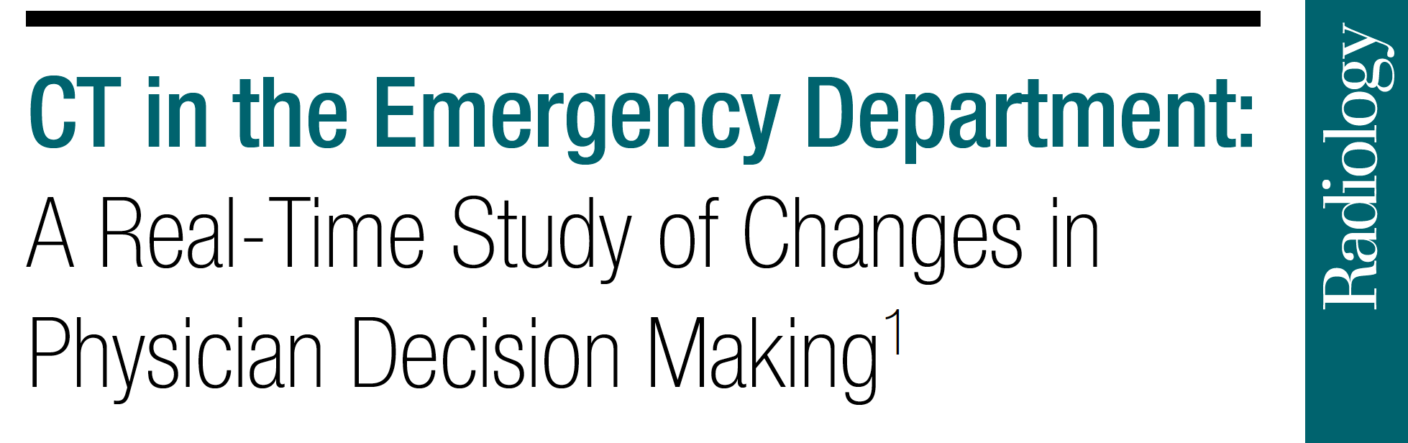
Pandharipande et al, Radiology (2016)

Slide 39
Four medical centers: Patients reporting to ED with abdominal pain, chest pain and/or dyspnea, or headache; referred for CT
Physicians surveyed before and after CT to determine
leading diagnosis,
diagnostic confidence,
alternative “rule out” diagnosis, and
management decisions.
1280 patients, 245 physicians

Slide 40
Four medical centers: Patients reporting to ED with abdominal pain, chest pain and/or dyspnea, or headache; referred for CT
Leading diagnosis changed in
51% patients with abdominal pain
42% for chest pain and/or dyspnea (42%)
24% with headache
Pre-CT diagnostic confidence was inversely associated with the likelihood of a diagnostic change (P = 0.0001).
CT helped confirm or exclude at least 95% of alternative diagnoses.
Admission decisions changed in
25% of patients with abdominal pain
19% with chest pain and/or dyspnea
19% with headache

Slide 41
How to quantify benefits of CT
Prospective, blinded, randomized trials
Gold standard
Available for new applications as part of demonstrating efficacy to payers, for example:
CT colonography
Coronary calcium screening or coronary CT angiography
Lung cancer screening in high risk patients

Slide 42
National Lung Screening Trial (NLST)
In 2010, demonstrated that CT lung cancer screening is associated with a statistically significant mortality reduction of 20% from lung cancer and 7% from all causes
In 2012, American Lung Association recommended CT lung cancer screening for smokers and former smokers.
World waits for other large trials to confirm findings

Slide 43
Dutch-Belgian Randomized Lung Cancer Screening (NELSON)
In 2018, demonstrated statistically significant mortality reduction from lung cancer of 26% at 10 years (males) and 39% (females)
Individual flagged as having a lung nodule during screening had a 41% risk of having lung cancer
69% of the screen-detected lung cancers were stage IA or IB cancers; only 10% to 12% were stage IV
50% of the cancers in the control group were stage IV when detected

Slide 44
How to quantify benefits of CT
Some studies simply not feasible (or even ethical) in many well established uses
Can’t withhold CT in trauma patients to test outcomes
Consensus guidelines from expert panels
American College of Radiology Appropriateness Criteria
http://www.acr.org/Quality-Safety/Appropriateness-Criteria

Slide 45
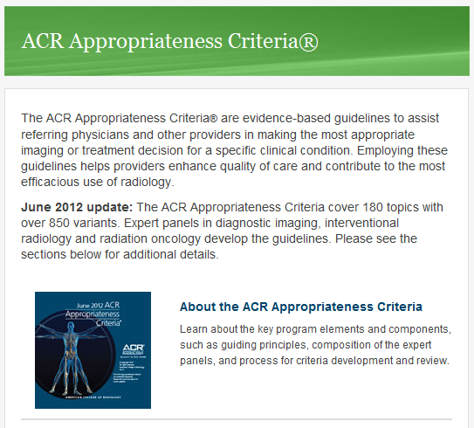
ACR Appropriateness Criteria (circa 2012)

Slide 46
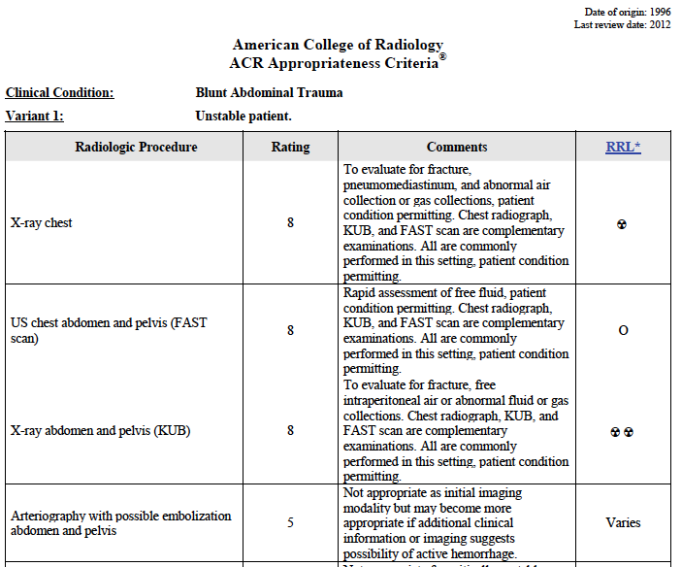
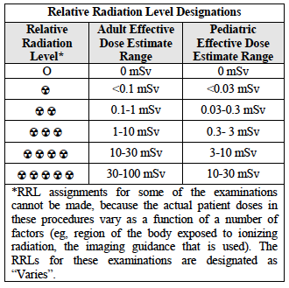

Slide 47
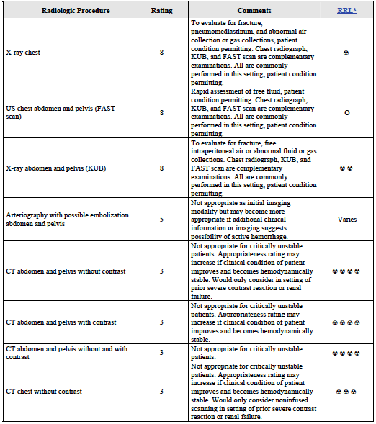
Blunt Abdominal Trauma
Unstable Patient

Slide 48
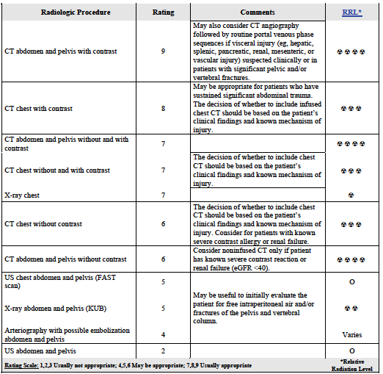
Blunt Abdominal Trauma
Stable Patient

Slide 49
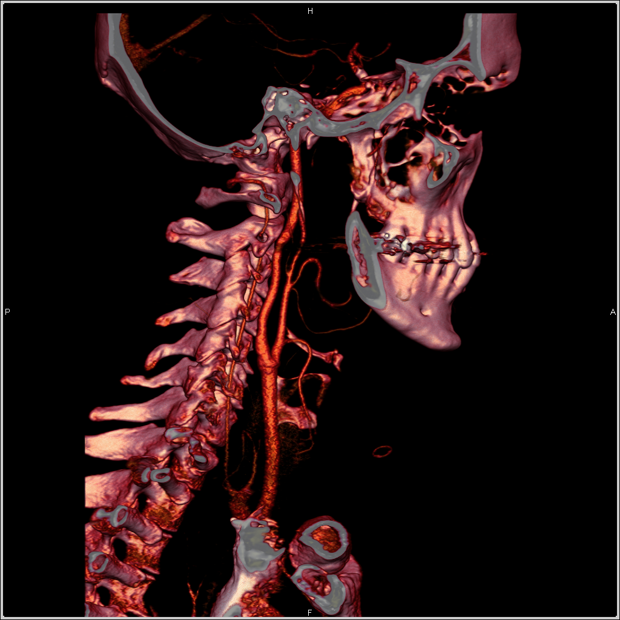
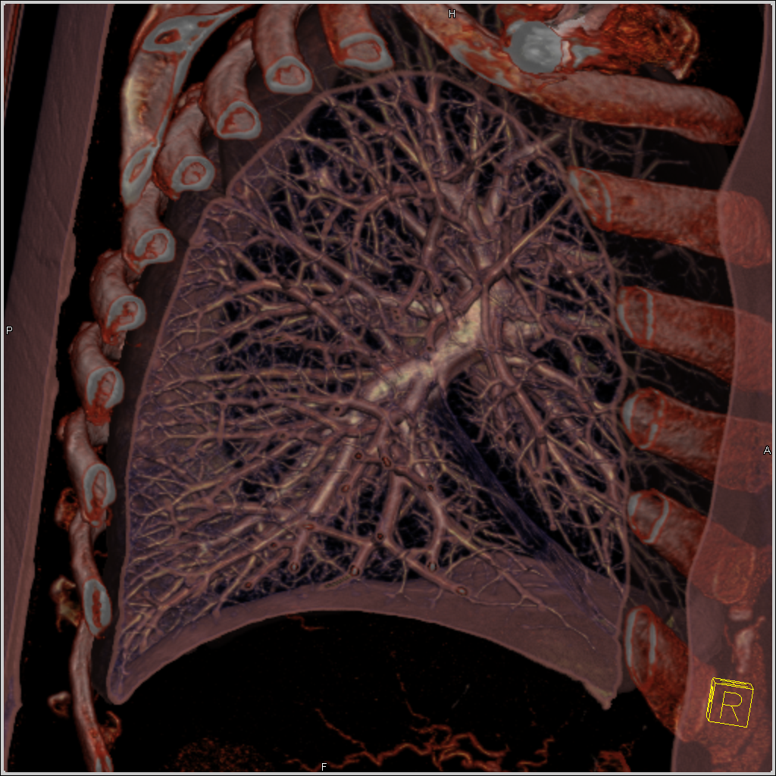
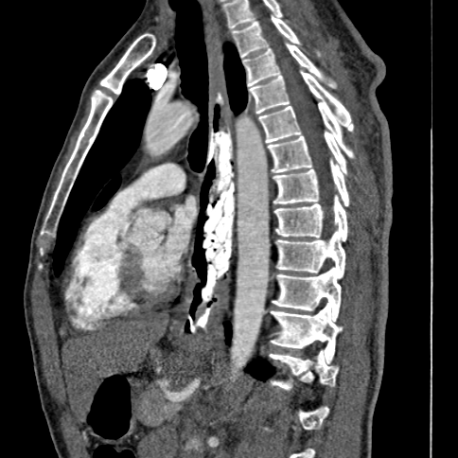










Slide 50
Clinical scenarios for which the ACR Neurologic expert panel considered CT as a most appropriate imaging modality
General Clinical Scenario | Scenario variants to which CT is a most appropriate exam (appropriateness rank, 7 - 9)
Head Trauma | Minor or mild acute closed head injury (GCS ≥13), w/o risk factors or neurologic deficit (7)
 | Minor or mild acute closed head injury, focal neurologic deficit, and/or risk factors (9)
 | Moderate or severe acute closed head injury (9)
 | Mild or moderate acute closed head injury, child <2 years old (9)
 | Closed head injury; rule out carotid or vertebral artery dissection (8) *
 | Penetrating injury, stable, neurologically intact (9)
 | Skull fracture (9)
Headache | Sudden onset of severe headache (w/o contrast 9, w/contrast 8 *)
 | Sudden onset of unilateral headache, suspected carotid or vertebral dissection (8) *
 | New headache in pregnant patient (8) *
 | New headache. Suspected meningitis/encephalitis (8) *
Neck Mass/Adenopathy | Adult presenting with a nonpulsatile solitary neck mass (afebrile) (9)
 | Adult presenting with a solitary neck mass (febrile) (9)
 | Adult presenting with a pulsatile neck mass (9)
 | Adult presenting with multiple neck masses (9)
 | Adult with a history of treatment for cancer presenting with a neck mass (9) *
Sinonasal Disease | Acute or subacute rhinosinusitis in immunodeficient patient (7)
 | Acute or subacute rhinosinusitis w/ orbital, intracranial, ocular or neurologic symptoms (9) *
 | Recurrent acute or chronic rhinosinusitis (possible surgical candidate) (9)
 | Sinonasal polyposis (9)
* Other modalities have same appropriateness ranking.

Slide 51
Abdominal Aortic Aneurysm (AAA): Repair planning and follow-up
General Clinical Scenario | Scenario variants to which CT is a most appropriate exam (appropriateness rank, 1 - 9)
AAA: Interventional Planning and Follow-up | Planning for pre-endovascular repair or open repair of AAA (9)
 | Follow-up for post-endovascular repair or open repair of AAA (9)
* Other modalities have same appropriateness ranking.

Slide 52
Aortic stent
Courtesy of Dr. Terri Vrtiska

Slide 53
Consequences of alarmist media messaging
84 y.o. male
Abdominal aortic aneurysm
Pre-surgical CT Angiogram ordered
Leaves message for physician “requesting that his CT ‘with the cancer-causing stuff’ be changed to an ultrasound”
Numerous cancelled appointments after each round of media coverage
Media is driving this story, not science

Slide 54
Head to toe summary of appropriateness (MSK, breast and women’s imaging, pediatric imaging not included here)
Specialty | Variants | CT is one of the most appropriate |  | CT is the only most appropriate
GU | 50 | 29 | 58% | 20 | 40%
GI | 53 | 30 | 57% | 18 | 34%
Vascular | 21 | 9 | 43% | 8 | 38%
Neuro | 137 | 55 | 40% | 30 | 22%
Thoracic | 51 | 17 | 33% | 9 | 18%
Cardiac | 10 | 3 | 30% | 1 | 10%
Total | 322 | 143 | 44% | 86 | 27%

Slide 55
So … should we reduce CT dose or not ?
YES (but not too much)
Not necessarily because it causes cancer
But because people fear it will cause cancer
Fear has consequences
missed or delayed diagnoses or treatment
higher health care costs
anxiety and emotional distress
Also, because CT is so beneficial, many people will receive multiple CT exams
Want them to get the care they need without fear/worry
Want them to get the most effective medical care

Slide 56


Low Dose can Destroy Justification (Benefit)
Courtesy of Dr. Joel Fletcher
Low dose 6 mm thick
Single phase
-----
Pancreatic tumor missed
2 days later
Routine dose 2 mm thick
Bi-phasic
-----
Clear low atten. mass Ductal dilation
Notes:
Top row – imatron scan at so low a dose and 6 mm slice thickness that pancreatic tumor not called by radiologist
Bottom row – dedicated biphasic pancreas CT on MDCT scanner 2 days later – clear low attenuation mass and pancreatic ductal dilation

Slide 57
Balancing Benefit and Risk
Benefit
Risk
“Risk”
Risk
Justification driven by BENEFIT
Once exam is justified, then optimize
Optimization may mean dose increase
Notes:
Embraces the guiding principles of radiation protection

Slide 58

This is so logical. Why isn’t it working?

Slide 59

Perception of risk is not logical
Courtesy of Dick Vetter

Slide 60
Closing thoughts
Rodger McClellan: Establishing and using rad protection standards involves multiple entities with different roles
Those who create scientific knowledge
Those who synthesize scientific knowledge
Those who set standards
Those who enforce standards

Slide 61
Who medicine needs? Those who …
weight the demonstrated benefits over the
unable to be agreed upon,
small, or
potentially non-existent risks
and responsibly distill knowledge
into societally responsible messages
for the benefit of the general public and
for clear communication to the general public.
*
* Roger McClellen: It’s hell to be poor – that’s a real risk!

Slide 62
Medical imaging is safe
Yes it should be justified
but the bar for ordering should be low (remember Bryan Salinas)
Yes it should be optimized
but ALARA needs to take into account diagnostic performance (remember pancreatic insulinoma case)
Caveats are useful for medical providers, as they should all
be good stewards of medical resources
order medical procedure appropriately
perform medical procedures safely
Regulations/accreditation requirements/quality initiatives in medical imaging are good and necessary to ensure a safety culture and appropriate user education
But, we need to do a MUCH better job at giving a unified message

Slide 63
When medical imaging will provide useful information, get it and don’t worry about it
Thank you very much
www.mayo.edu/ctcic

